Slide 1
Air Quality Project
Assignment 3: Openair Primer
And Intro to Assignment 4: Preliminary Presentation

Slide 2
Agenda
Download the R openair package and practice data
Learn openair functions
Understand common air quality data plots

Slide 3
Install Openair
Open RStudio and execute: install.packages("openair")
openair along with other necessary sub-packages will begin downloading immediately.
Next, open a browser tab with the super friendly openair manual for reference: https://bookdown.org/david_carslaw/openair/ If you really want to dig in, you can also go to the github repository for the entire library: https://github.com/davidcarslaw/openair

Slide 4
Call Libraries
Open a new script file and name it openair_primer_firstname_lastname.R to keep track of these function calls for your reference. Import the necessary libraries: library(openair) # vis pkg library(tidyverse) # helps vis pkg
(Remember, you need to call the libraries every time you restart R)

Slide 5
Get Data
We’re going to download our data from openair via an API, which is a repository of data that can be accessed directly from code commands. Specifically, the data that we will be using is from the UK's Automatic Urban and Rural Network (AURN).
Run the following to import your data:
data <- importAURN(site = "my1", year = 2000:2005)
If this doesn’t work, you can download a openair_primer_dataset.csv from Canvas and use readcsv. data <- read.csv(file.choose())
For the project, you will have pre-cleaned data, but it is important to know about openair’s capabilities (and the capabilities of APIs) for future use!

Slide 6
View Data
Once the data is imported, you can click on the object in your workspace to view it, or run the command head(data) to see some of the data.
First, on your answer sheet: What do you notice? (Any interesting formatting of entries? Any columns you can recognize before going further?)

Slide 7
Columns
Variable Name | Meaning
 | The name of the collection location
 | The code for importing this site through the API
 | Date and time listed as yyyy-mm-dd hh:mm:ss
 | The level of carbon monoxide in μg/m^3
 | The level of other nitrous oxides (not no2 or no) in μg/m^3
 | The level of nitrogen dioxide in μg/m^3
 | The level of nitrogen monoxide in μg/m^3
 | The level of ozone in μg/m^3
 | The level of sulfur dioxide in μg/m^3
 | The level of particulate matter of 10 micron size in μg/m^3
 | The level of particulate matter of 2.5 micron size in μg/m^3
 | The speed of the wind in m/s
 | The direction of the wind in compass degrees (0º north, clockwise around)
As a class, complete the table to match the column names to their meaning:

Slide 8
Columns (Answers)
Variable Name | Meaning
site | The name of the collection location
code | The code for importing this site through the API
date | Date and time listed as yyyy-mm-dd hh:mm:ss
co | The level of carbon monoxide in μg/m^3
nox | The level of other nitrous oxides (not no2 or no) in μg/m^3
no2 | The level of nitrogen dioxide in μg/m^3
no | The level of nitrogen monoxide in μg/m^3
o3 | The level of ozone in μg/m^3
so2 | The level of sulfur dioxide in μg/m^3
pm10 | The level of particulate matter of 10 micron size in μg/m^3
pm2.5 | The level of particulate matter of 2.5 micron size in μg/m^3
ws | The speed of the wind in m/s
wd | The direction of the wind in compass degrees (0º north, clockwise around)

Slide 9
Plot 1: timePlot
Now let’s first check our data by creating a simple plot: the value of our variables over time. The best way to do this clearly and concisely is to use the openair function timePlot() (plots the pollutant nox by default) timePlot(data) To specify one or more variables to plot, as well as the option to average over time:
timePlot(data, pollutant = c("no", "no2", "nox", "o3"),avg.time="month")
Once plotted, you may need to adjust your plots window to fully see the data. You can do this by clicking and dragging the bar dividing the files window and plots window.
Finally, answer the 3 questions about time plots on your answer sheet.

Slide 10
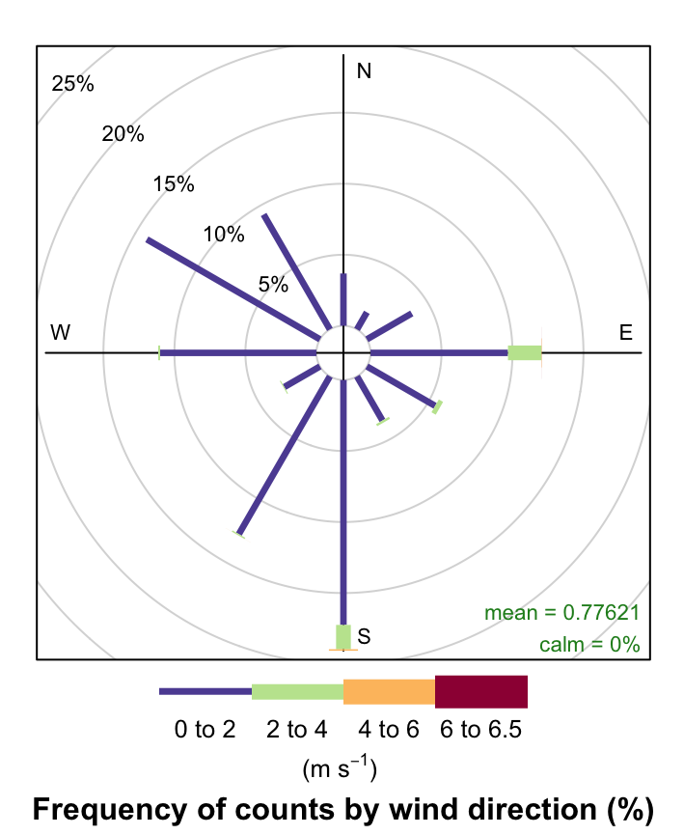
Plot 2: windRose
Next, we’ll create one of the most important plots: a windrose. Run the command windRose(). windRose(data) Let’s walk through the questions about this plot together on the next slides.

Slide 11
windRose Questions
This plot produces 12 bars jutting out on a polar plot. What do the directions of these bars correspond to?
The legend below the plot lists a range of values for each color with units of (m s⁻¹), what do the values correspond to (think about what variable has those units)?

Slide 12
windRose Questions
The plot is titled “Frequency of counts by wind direction (%).” If this is the case, what do the lengths of the bars represent (look at the units on the concentric rings)?
In the lower right corner of the plot are values for the “mean” and “calm”, what do these mean (hint: mean is in m s⁻¹ and you can check if the wind speed ever hits zero by making a plot of wind speed)?

Slide 13
windRose Questions
Finally, using the previous questions as necessary, explain what a windRose shows (1-2 sentences).

Slide 14
windRose Arguments
As before, we can use internal arguments to specify further.
windRose(data, type="year", layout=c(3, 2))
How does type = “year” separate the data? How about type = “pm10”?
windRose(data, type="pm10", layout=c(3, 2))
What is the data binned by now? Explore the different variations of windroses given type and variable. Export one that you produced of your choice, something that piques your interest. Explain what your windRose shows. Are there any conclusions you can draw?

Slide 15
Plot 3: pollutionRose
We can make a variation of a windRose called pollutionRose (nox by default). pollutionRose(data) To focus on a specific pollutant, use the pollutant argument: pollutionRose(data, pollutant="no") To link with another pollutant, use the type argument: pollutionRose(data, pollutant="no", type="no2", layout=c(4, 1)) To segment (remove the spaces between the bars) and normalize: pollutionRose(data, pollutant="nox", seg=1, normalise=TRUE)
Finally, answer the questions about pollutionRoses on your answer sheet

Slide 16
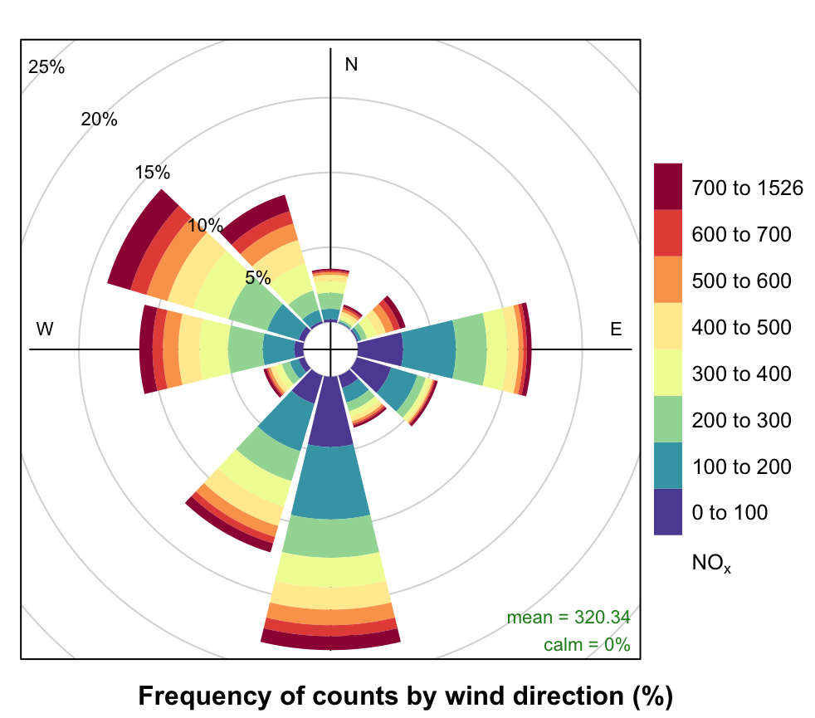
pollutionRose challenge
Using the command pollutionRose() and knowledge of R and openair syntax, make a pollution rose for only the year 2002 that is tracking the level of pm10.
Submit your code you used to create this plot, including the commands to set up the file and import the data

Slide 17
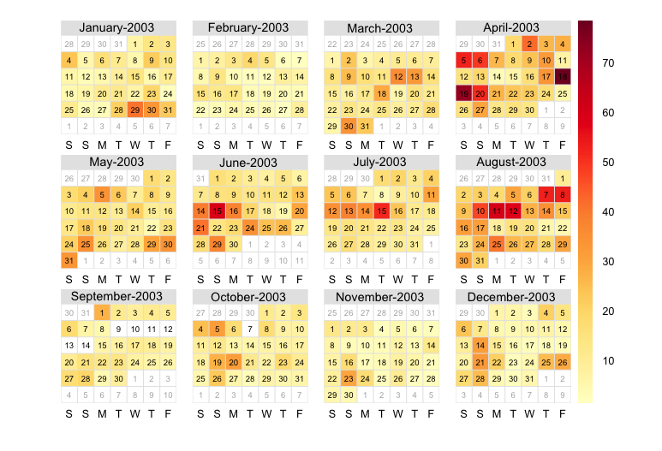
Plot 4: calendarPlot
Begin with the calendar plot using the command: calendarPlot(data)
If you wish, you can also add the wind as a vector to each day on the calendar: calendarPlot(data, annotate="ws")
Answer the questions about calendarPlot on your answer sheet.
Notes:
Skippable, can be done independently

Slide 18
Plot 5: polarAnnulus
As a broader view of pollutants over time, we can create a polar annulus to view pollution on various time scales. Begin with these 3 kinds:
polarAnnulus(data, poll="nox", period="season", main="Season")
polarAnnulus(data, poll="nox", period="weekday", main="Weekday")
polarAnnulus(data, poll="nox", period="hour", main="Hour")
Answer the questions about polarAnnulus on your answer sheet.
Notes:
Skippable, can be done independently

Slide 19
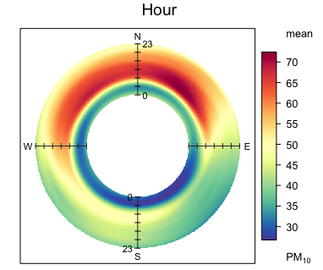
Plot 5: polarAnnulus Example
Notes:
Skippable, can be done independently

Slide 20
Plot 6: scatterPlot
Finally, we’ll create a common plot for any science, the scatter plot. This command exists in base R, but openair has embellished it for our use.
Use the command scatterPlot to compare “no” on the x-axis and “nox” on the y-axis: scatterPlot(data, x = "...", y = "...")
It may be valuable to subset your data from a specific year first. You can do this by using openair’s handy “selectByDate” function. We can’t quite use logical selection like last time because of the way that the date is formatted: data2000 <- selectByDate(data, year = 2000)

Slide 21
Plot 6: scatterPlot (cont)
Even with this reduction, our scatterPlot may be messy because of overlapping points. We can make our scatterplot a hexbin type to log these overlapping points differently.
Add to your scatterPlot command the arguments method="hexbin" and col="jet" to do this.
Finally, answer the questions about scatterPlot on your answer sheet.

Slide 22
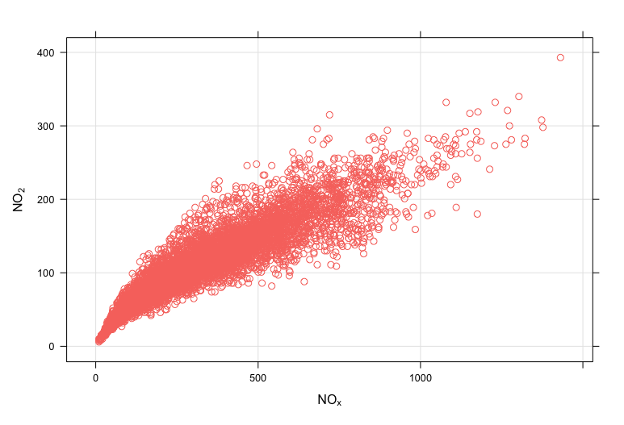
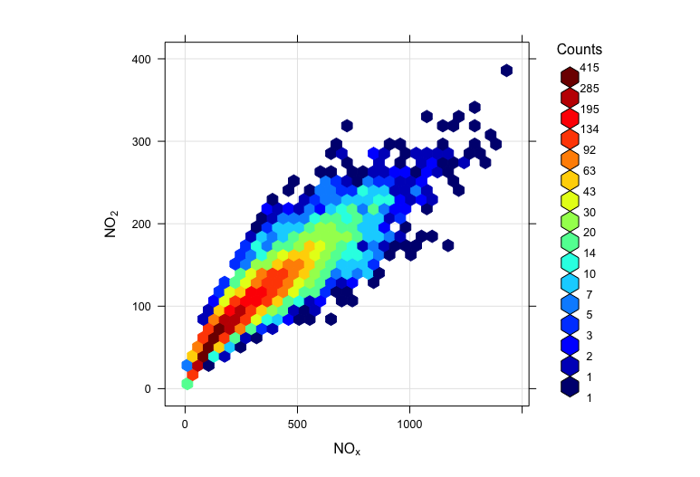
Plot 6: scatterPlot Examples:

Slide 23
Closing Exercise: Your Choice!
Go to the openair manual (https://bookdown.org/david_carslaw/openair/) and find one plot that we have not seen or used today. Run the command to produce that plot for your data, paste it, and describe what the plot shows. Remember that all openair functions use similar internal arguments.
Notes:
Skippable, can be done independently

Slide 24
Looking Ahead: Prelim Presentations
Read through the Preliminary Presentations description on Canvas or in the Class Drive
Note the major components:
Research Question
Figures (like some you made today)
Progress & Questions
This is your chance to give and receive peer feedback!
Questions?
Notes:
Skippable, can be done independently

